Slide 1
Social Graphs and Semantic Analytics
Colin Bell <colin.bell@uwaterloo.ca>
Director, Enterprise Architecture
Information Systems and Technology (IST)
University of Waterloo
Prepared guest lecture for Class 11 of W16 cs330.

Slide 2
Foundations
Infrastructure
Business Use
Managerial and Social Issues
Building

Slide 3
Foundations so far…
Business Intelligence (BI)
Data Warehousing
Big Data
Social IT
I will lay base for next generation BI and the technology being used at the bleeding edge to make sense of big data.
“Business Intelligence 2.0”
Graph databases
Semantic-aware analytics

Slide 4
Outline: Class 11 – Guest Lecture “Social Graphs and Semantic Analytics”
Foundations
Graph (mathematics)
Semantics (linguistics)
Infrastructure
Web 2.0
Web 3.0
Business Uses
Social Graph
Financial Risk
Meta-Analysis
Managerial and Social Issues
Profiling
Information Leakage
False Positives
Building
Where would you start?

Slide 5
Tim Berners-Lee: Director W3C
``To a computer, the Web is a flat, boring world, devoid of meaning. This is a pity, as in fact documents on the Web describe real objects and imaginary concepts, and give particular relationships between them. For example, a document might describe a person. The title document to a house describes a house and also the ownership relation with a person. Adding semantics to the Web involves two things: allowing documents which have information in machine-readable forms, and allowing links to be created with relationship values. Only when we have this extra level of semantics will we be able to use computer power to help us exploit the information to a greater extent than our own reading.’’ - Tim Berners-Lee "W3 future directions" keynote, 1st World Wide Web Conference Geneva, May 1994
I express my network in a FOAF file, and that is a start of the revolution. - TimBL 2007, Giant Global Graph (foaf)
From http://xmlns.com/foaf/spec/

Slide 6
Foundations: Graph
Definition:
Set V of vertices.
Set E of unordered (edge) and ordered (arc) pairs of vertices.
Denoted as G(V,E).
Types:
Undirected Graph (G_{u})
Directed Graph (G_{d})
Mixed Graph (G_{x})
Multigraph (G_{m})
Graph. Encyclopedia of Mathematics. URL: http://www.encyclopediaofmath.org/index.php?title=Graph&oldid=37438
http://bit.ly/1Ue3Jby

Slide 7
Foundations: Semantics
Definition: Semantics
The branch of linguistics and logic concerned with meaning. There are a number of branches and sub branches of semantics, including:
formal semantics, which studies the logical aspects of meaning, such as sense, reference, implication, and logical form,
lexical semantics, which studies word meanings and word relations, and;
conceptual semantics, which studies the cognitive structure of meaning.
We are interested in Computational Semantics, the study of how to automate the process of constructing and reasoning with meaning representations [source: https://en.wikipedia.org/wiki/Computational_semantics]
Semantics. Oxford Dictionary Online. URL:
http://www.oxforddictionaries.com/us/definition/american_english/semantics
http://bit.ly/1pYQ8bg

Slide 8
Foundations: Semantic Models
a.k.a. Semantic Networks
We can combine the concepts of graphs and semantics to build what are called semantic models.
Example:

Slide 9
NOTE Infrastructure
This is a whirlwind tour of technologies. This is to give you a frame of reference not an exhaustive understanding. Some of this may be review, some of it may be new.
If you miss the details, do not fret.

Slide 10
Infrastructure: Web 2.0- Social
A number of concepts and technologies make up what we think of as Web 2.0. We’ll look at a few:
HTTP: Hypertext Transfer Protocol
URLs: Uniform Resource Locators
A specific type of Uniform Resource Identifier (URI)
HTML: Hypertext Markup Language
With JavaScript and Cascading Style Sheets (CSS)
XML: Extensible Markup Language
Web Services:
SOAP: Simple Object Access Protocol
RESTful JSON: Representational State Transfer JavaScript Object Notation

Slide 11
Web 2.0: HTTP
Hypertext Transfer Protocol (HTTP)
Provides a simple dialect (verbs + structure) to ask for, give, and receive hypertext/hypermedia-based information.
Usually transferred using Transmission Control Protocol (TCP) over Internet Protocol (IP) switched networks.
Allows creation of a graph containing ‘hypertext’ vertices (nodes) linked across ‘hyperlink’ arcs.
The basis of the World Wide Web we know today.

Slide 12
Web 2.0: HTTP
See: https://tools.ietf.org/pdf/rfc7231.pdf

Slide 13
Web 2.0: HTTP
See: https://tools.ietf.org/pdf/rfc7231.pdf

Slide 14
Web 2.0: URLs / URIs
A Uniform Resource Locator (URL) is a specific class of Uniform Resource Identifier (URIs)
See: https://www.ietf.org/rfc/rfc3986.txt
The standardized structure of a string to allow items to be uniquely identified (URI). Sometimes items are best identified by its location (URL).
Pattern:
foo://example.com:8042/over/there?name=ferret#nose \_/ \______________/\_________/ \_________/ \__/
| | | | |
scheme authority path query fragment
Example from IETF RFC3986

Slide 15
Web 2.0: HTML w/ (JS + CSS)
Hypertext Markup Language (HTML)
See: https://www.w3.org/TR/html5/
Most modern websites include JavaScript (JS) to allow for ‘dynamic’ interactions.
See: http://www.ecma-international.org/ecma-262/5.1/
Data (HTML) and dynamic logic (JavaScript) is separated from visual presentation using Cascading Style Sheets (CSS).
See: https://www.w3.org/TR/CSS/

Slide 16
Web 2.0: Example HTML
http://ist.uwaterloo.ca/~cpbell/1161.cs330/SOURCES/HTML-example/
<!DOCTYPE html>
<html>
<head>
<meta charset="utf-8" />
<script type="text/javascript"src="script.js”>
</script>
<link rel="stylesheet”
type="text/css”
href="style.css">
</link>
</head>
<body>
<h1>Example HTML</h1>
<button onclick="sayHello('world')">
Click Me
</button>
</body>
</html>

Slide 17
Web 2.0: Example JavaScript
http://ist.uwaterloo.ca/~cpbell/1161.cs330/SOURCES/HTML-example/
function sayMessage(parameter) {
window.alert(parameter)
}

Slide 18
Web 2.0: Example CSS
http://ist.uwaterloo.ca/~cpbell/1161.cs330/SOURCES/HTML-example/
button {
background-color: #4CAF50; /* Green */
border: none;
color: white;
padding: 15px 32px;
text-align: center;
text-decoration: none;
display: inline-block;
font-size: 16px;
}
body { background-color: lightgreen; }
h1 { color: darkgreen;
margin-left: 20px;
}

Slide 19
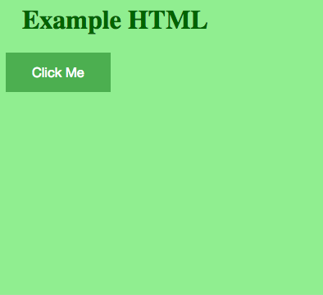
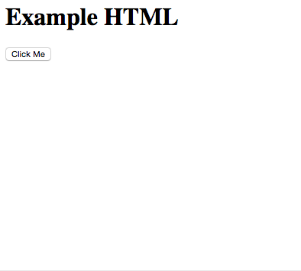
Web 2.0: HTML Example
http://ist.uwaterloo.ca/~cpbell/1161.cs330/SOURCES/HTML-example/
With CSS + JavaScript
Without CSS + JavaScript

Slide 20
Web 2.0: XML
Extensible Markup Language (XML)
See: https://www.w3.org/TR/xml/
Provides a way to structure (aka ‘markup’) arbitrary text content with tags so a computers and humans can read it.
Ostensibly the parent of HTML.
Expands on an older format called the Standard Generalized Markup Language (SGML).
Example uses:
Microsoft Office Files (docx, xlsx, pptx)
Really Simple Syndication (RSS) feeds
https://en.wikipedia.org/wiki/List_of_XML_markup_languages

Slide 21
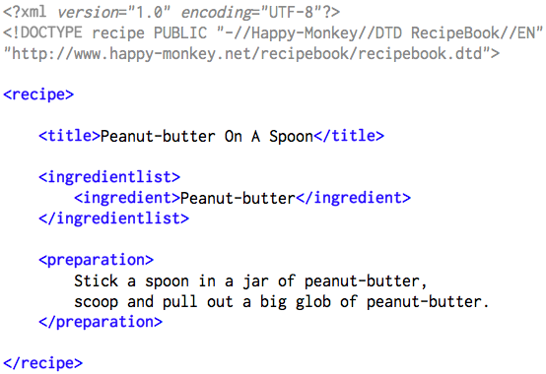
Web 2.0: XML Example
Public Domain from: https://en.wikipedia.org/wiki/File:RecipeBook_XML_Example.png

Slide 22
Web 2.0: Web Services
Today you learned about a number of ‘Social IT’ innovations– the innovations that moved the WWW from its Web 1.0 early past to its Web 2.0 social present.
One of the key elements of the Web 2.0- Social Web revolution was the ability to access data from different services (Wikis, Blogs, Microblogs, etc.)
Application Programming Interfaces (APIs) were key to this. When APIs work over HTTP, they are called ‘Web Services.’
“A Web Service is a software system designed to support interoperable machine-to-machine interaction over a network.” source: https://www.w3.org/TR/2004/NOTE-ws-gloss-20040211/#webservice

Slide 23
Web 2.0: SOAP
Simple Object Access Protocol (SOAP)
See: https://www.w3.org/TR/soap12/
``A SOAP message is an ordinary XML document containing the following elements:
An Envelope element that identifies the XML document as a SOAP message
A Header element that contains header information
A Body element that contains call and response information
A Fault element containing errors and status information’’
From http://www.w3schools.com/xml/xml_soap.asp

Slide 24
Web 2.0: SOAP Example
From https://en.wikipedia.org/wiki/SOAP under CC-Attribution-SA
POST /InStock HTTP/1.1
Host: www.example.org
Content-Type: application/soap+xml; charset=utf-8
Content-Length: 299
SOAPAction: http://www.w3.org/2003/05/soap-envelope
<?xml version="1.0"?>
<soap:Envelope xmlns:soap="http://www.w3.org/2003/05/soap-envelope">
<soap:Header> </soap:Header>
<soap:Body>
<m:GetStockPrice xmlns:m="http://www.example.org/stock/Surya">
<m:StockName>IBM</m:StockName>
</m:GetStockPrice>
</soap:Body>
</soap:Envelope>

Slide 25
Web 2.0: RESTful JSON
Representational State Transfer (REST)
See Fielding, Roy Thomas. Architectural Styles and the Design of Network-based Software Architectures. Doctoral dissertation, University of California, Irvine, 2000. @ http://bit.ly/1eTY8AI
Architecture that uses HTTP and URIs/URLs to convey information constrained in specific ways.
JavaScript Object Notation (JSON)
JSON: http://www.json.org/
A lightweight data-interchange format built on a (1) collection of name/value pairs and (2) an ordered list of values.

Slide 26
Web 2.0: RESTful JSON Example
GET /InStockJSON/stock/Surya/StockName/IBM HTTP/1.1
Host: www.example.org
HTTP/1.1 200 OK
{
[ stock_name: “IBM”,
stock_value: {
price: “145.47”,
currency:”USD”
}
]
}

Slide 27
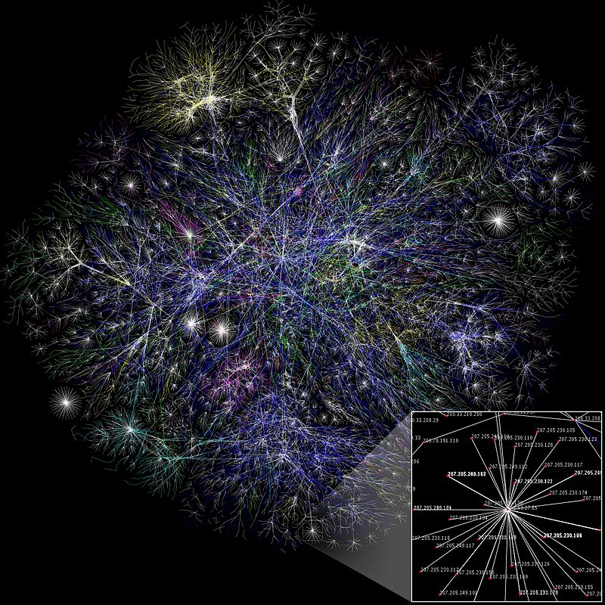
Web 2.0: WWW
What is the World Wide Web (WWW):
A huge directed graph of connected text and multimedia (nodes aka. vertices) across links (arcs).
The links are not very informative.
Knowing that one node links to another does not provide useful ‘rich’ context.
Connections do not have meaning outside of ‘link’.
By The Opte Project - Originally from the English Wikipedia; description page is/was here., CC BY 2.5, https://commons.wikimedia.org/w/index.php?curid=1538544
See more large network datasets at:
https://snap.stanford.edu/data/#web

Slide 28
Motivation: Web 3.0
Simple links do not say much.
Human inference can (sort of) fill in the blanks.
We want computers to do the hard work.
A human can look at 4 articles / social media profiles.
A human cannot look at billions of articles / social media profiles.

Slide 29
Motivation: Web 3.0
Can we combine these two graphs into something a computer can understand and use to infer meaning / relationships?
Semantic Model
Hypermedia Graph

Slide 30
Motivation: Web 3.0

Slide 31
Infrastructure: Web 3.0- Semantic
To help deal with this lack of meaning from links, the World Wide Web Consortium (W3C) has been working to develop a suite technologies to encode semantics.
They are referred to as Web 3.0- “The Semantic Web.”
These technologies are built on the W3C’s previous standards– the Web 1.0 and Web 2.0 standards.
They are:
RDF: Resource Description Framework
SPARQL: RDF Query Language
OWL: Web Ontology Language

Slide 32
Web 3.0: RDF
Resource Description Framework (RDF)
See: https://www.w3.org/standards/techs/rdf
RDF is a family of specifications that simplify building graphs made of triples (Subject, Predicate, Object).
It allows large Graph Databases to be built storing more than simple links. They store meaning and interrelations (semantics) in a way that computers can process them.
From:
https://www.w3.org/TR/2014/REC-rdf11-concepts-20140225

Slide 33
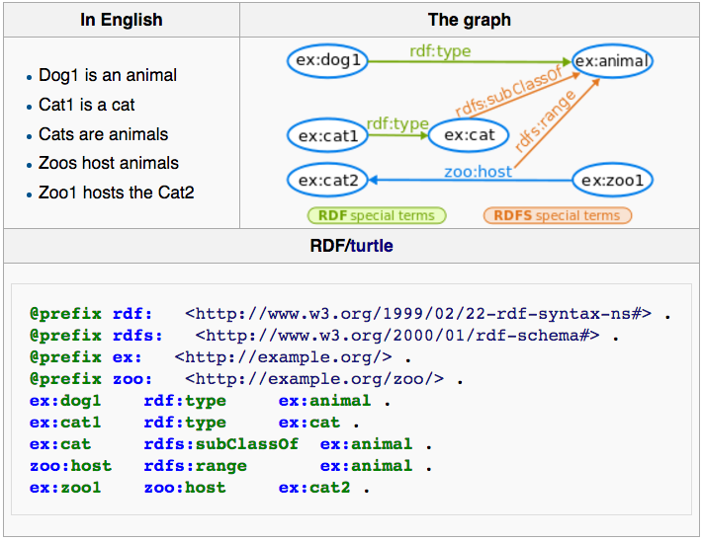
Web 3.0: RDF Example
From https://en.wikipedia.org/wiki/RDF_Schema

Slide 34
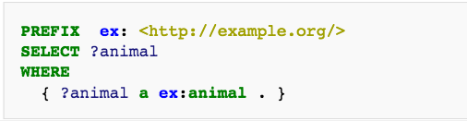
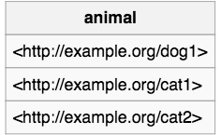
Web 3.0: SPARQL
RDF Query Language (SPARQL)
See: https://www.w3.org/TR/rdf-sparql-query/
SPARQL queries usually contain a set of triple patterns called a basic graph pattern. They are like RDF (subject, predicate, object) where each parameter can be a variable.
Example: https://en.wikipedia.org/wiki/RDF_Schema

Slide 35
Web 3.0: OWL
Web Ontology Language (OWL)
See: https://www.w3.org/standards/techs/owl
An ontology is ‘a set of concepts and categories in a subject area or domain that shows their properties and the relations between them.’ [source: http://www.oxforddictionaries.com/definition/english/ontology]

Slide 36
Semantic Analytics Business Uses
This Semantic Web stuff looks really complicated, why should I care?
You can’t look at a billion sites, but your computers can.

Slide 37
Uses: Social Graph
Extend the challenges of the the relatively flat World Wide Web to Social IT.
What is the nature of your relationship with that person?
What does your ‘Like’ or ’Retweet’ or ‘Repost’ mean?
Do you agree?
Do you disagree and want to share that disagreement with others?
What are you interested in?
With flat ‘links’ and ’likes’, valuable information is lost.

Slide 38
Uses: Social Graph
Enter the Ontologies / RDF specs for different views of the Social Graph.
FOAF – Friend of a Friend: http://xmlns.com/foaf/spec/
W3C’s early specification for describing relationships between people

Slide 39
Uses: Social Graph
SIOC -- Semantically-Interlinked Online Communities: https://www.w3.org/Submission/sioc-spec/
Developed by Science Foundation Ireland.

Slide 40
Uses: Social Graph
The Open Graph Protocol: http://ogp.me/
Developed by Facebook with developer simplicity in mind.
Implemented in RDFa allowing semantic context to be added quickly and easily to any web page.

Slide 41
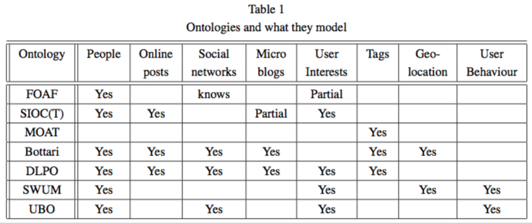
Uses: Social Graph
FOAF, SIOC, and Open Graph all strive to add more context to the links in the graph. The challenge with standards is there are many options.
Citation: http://semantic-web-journal.org/sites/default/files/swj303_0.pdf
Notes:
From http://semantic-web-journal.org/sites/default/files/swj303_0.pdf
FOAF (an acronym of Friend of a friend)
SIOC (Semantically-Interlinked Online Communities)
MOAT (Meaning- Of-A-Tag) ontology
General User Modelling Ontology (GUMO)
Bottari
DLPO (The LivePost Ontology)
SWUM (Social Web User Model)
User Behaviour Ontology

Slide 42
Uses: Financial Risk
EDM Council (http://edmcouncil.org)
Produce the ‘Financial Industry Business Ontology (FIBO)’
Focus on understanding different organizations credit positions. Became very active after the 2008 financial crisis.
When it was not easy to unwind positions and understand what was exposed, the financial institutions realized they needed something better.
Now building towards reporting to each other and regulators through against the ontology.
See Semantic Repository @ http://edmcouncil.org/semanticsrepository/index.html

Slide 43
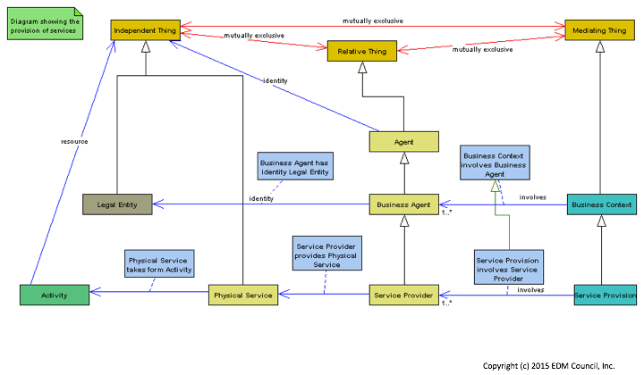
Uses: Financial Risk

Slide 44
Uses: Meta-Analysis
OpenText Election Tracker 16
Constrained Vocabulary and Ontology defined as Semantic Models.
Natural Language Processing (NLP) scans news articles and does analysis to build a representation of what the candidates are saying / having said about them.
See:
http://www.electiontracker.us/

Slide 45
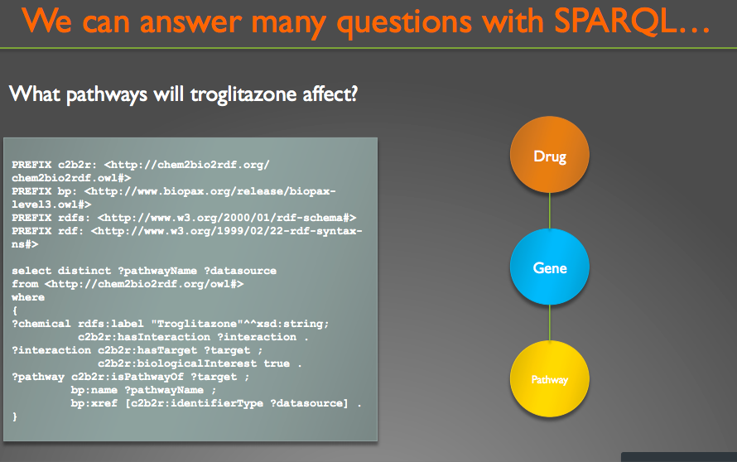
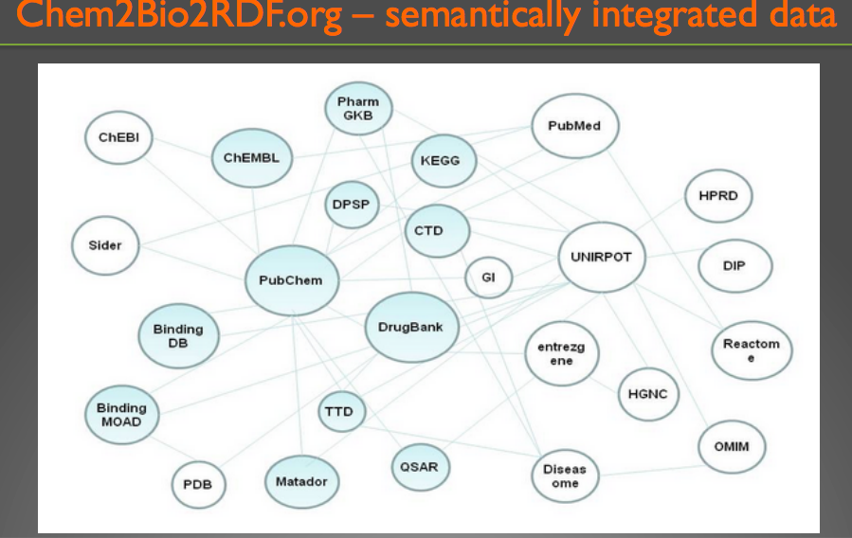
Uses: Meta-Analysis
Drug Discovery / Pathway Exploration
Wild, D.J., Ding, Y., Sheth, A.P., Harland, L., Gifford, E.M., Lajiness, M.S. Systems Chemical Biology and the Semantic Web: what they mean for the future of drug discovery research, Drug Discovery Today, 2012, 17, 469-474.

Slide 46
Semantic Analytics Issues
What are the managerial and social issues presented by Semantic Analytics?

Slide 47
Issues: Profiling
Facebook’s ad platform now guesses at your race based on your behavior
The company profiles users so it can sell against your "ethnic affinity."
Source: http://arstechnica.com/information-technology/2016/03/facebooks-ad-platform-now-guesses-at-your-race-based-on-your-behavior/
”ethnic affinity” is a relationship (predicate) that could be queried from a Social Graph using something like SPARQL.

Slide 48
Issues: Information Leakage
As an example: Palantir - https://www.palantir.com/
Have a platform for matching and building semantic relationships between large volumes of information from a large numbers of sources.
As more technology providers offer Semantic Web enabled platforms, more of your information will be able to be correlated without your knowledge.
If you are attempting to be anonymous but disclose enough semantic relationships about yourself, you could be re-identified.
See: https://www.palantir.com/2009/11/palantir-like-an-operating-system-for-data-analysis/

Slide 49
Issues: False Positives
Capturing complete ontologies is nearly impossible. Trade-offs usually required.
“Better is the enemy of good enough.”
What does ‘Like’ mean to Facebook?
If you ‘Like’ a story, are you liking the piece or the subject?
Constant improvements required to keep from having False Positive ‘Likes.’
Facebook making changes:
http://www.bloomberg.com/features/2016-facebook-reactions-chris-cox/

Slide 50
Semantic Analytics Building
Where would you start?

Slide 51
Where to start?
Read W3C Specifications.
Watch Tim Berners-Lee TED Talk:
https://www.ted.com/talks/tim_berners_lee_on_the_next_web?language=en
Cambridge Semantics (company) offers some good materials to get started:
http://www.cambridgesemantics.com/semantic-university/about-semantic-university

Slide 52
Questions?

Slide 53
Social Graphs and Semantic Analytics
Thank you!
Colin Bell <colin.bell@uwaterloo.ca>
Director, Enterprise Architecture
Information Systems and Technology (IST)
University of Waterloo
Prepared guest lecture for Class 11 of W16 cs330.

